Slide 1
SUPERFUND SITE MAPPING REVISITED: PREDICTIONS
PROJECT THREE
BIG DATA ENERGY
Notes:
Jack

Slide 2

TEAM MEMBERS
Jack Craft, Project Manager
Carl Mackensen, Subject Matter Expert
Noah Suskin, Analyst
Notes:
Jack

Slide 3
INTRODUCTION
Notes:
Transition: Jack → Carl

Slide 4
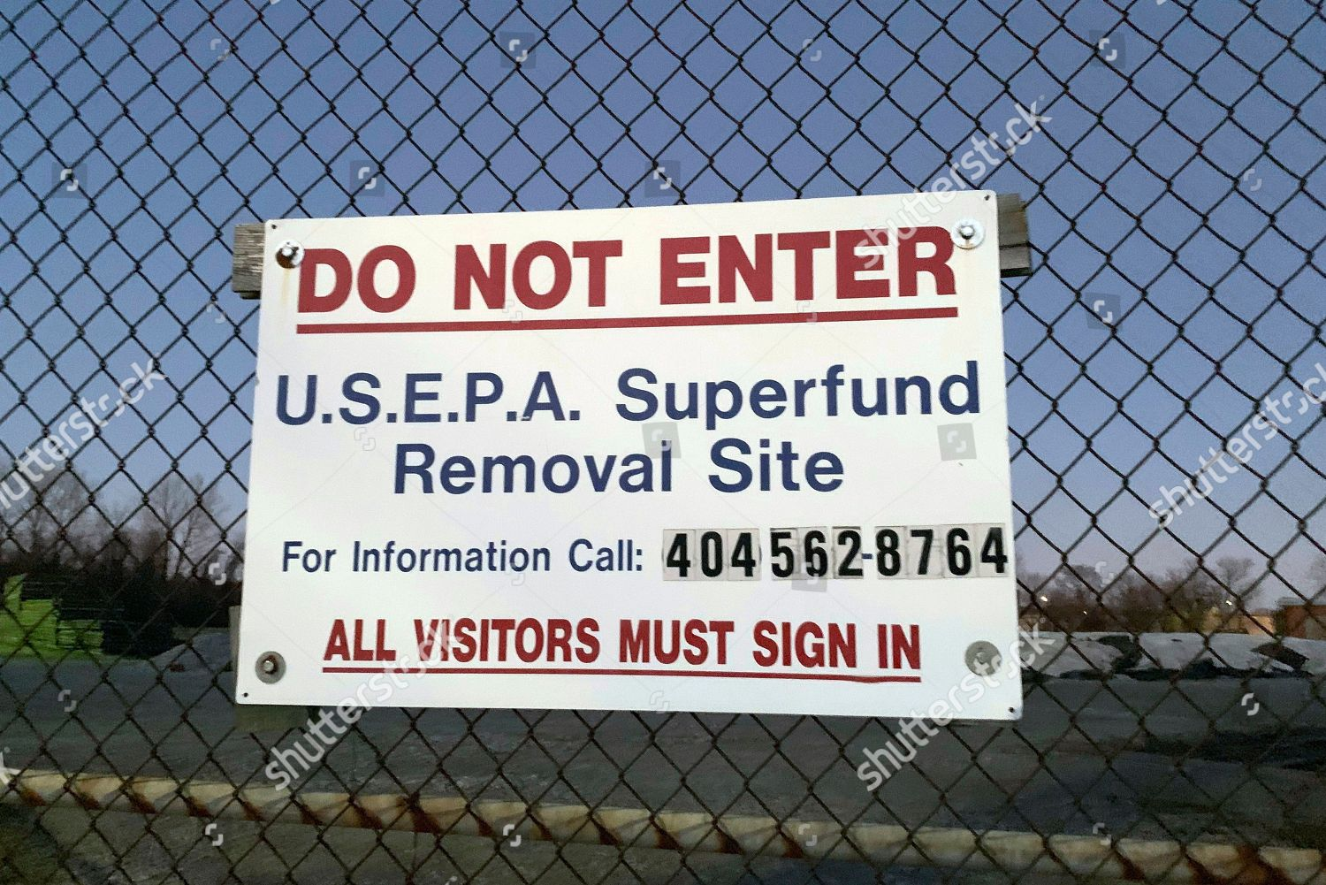
PREVIOUS WORK
Previously, we examined superfund site data for our visualization project.
We developed cluster mapping that showed sites with scores and addresses.
We also showed, via a state-by-state dropdown menu, metadata for states, as well as three plots illustrating relationships.
Notes:
Carl

Slide 5

THIS PROJECT
In this project, we use the same data set we used previously, but are answering different questions, and doing different things.
Superfund sites remain the same as we described them previously: toxic sites deemed by EPA to be needing clean up and remediation.
The Environmental Justice concern regarding the siting of superfund locations remains in the forefront of our minds, and guides our analysis
This time we seek, using machine learning models, to predict both whether a location has or will in the future have a site or not, and what the score of that potential or real site would be or is, based on certain key variables.
Notes:
Carl

Slide 6

DATA DESCRIPTION
The dataset we are working with comes from Kaggle, found at: https://www.kaggle.com/srrobert50/federal-superfunds
We started with a very comprehensive dataset with over 300 columns and 220 thousand observations.
This data is a composite of EPA data, for things like site information, and Census data, for socioeconomic data.
Notes:
Carl

Slide 7

NEW ANALYSIS
For this project, we used machine learning models to predict both the presence of sites, and the scores associated with those sites.
The presentation of this analysis are found on one new tab on the original website we made.
Cluster mapping remains present, but now we are including the predictions from our analyses.
The analysis took the form of random forest classification for the presence or absence of sites, and multivariable regression analysis for the site score.
These values populate the new website we have developed.
Notes:
Carl, Transition at end of slide: Carl → Jack

Slide 8

WHAT WE DID
We used a random forest model to predict the probability that a superfund site exists in an area given its census data. This is an imbalanced dataset (the census blocks without superfund sites far outnumber those that have them), so we used class weight balancing and feature reduction to get a more meaningful model (ROC-AUC score of 0.67).
For the multivariable regression, we took all the data and ran a regression. It was found that the r-squared was approximately 0.22, meaning that 22 percent of the variation in the data could be explained by the model.
We then used these models to make predictions of both presence or absence of sites for current and new locations, and their possible scores, given the variables we included.
Notes:
Jack

Slide 9
OUR PROCESS
Notes:
Jack

Slide 10












THE PROCESS
Step 1: Acquisition
Locate sources and download static data.
Research and review data definitions.
Step 2: Cleaning
Review data and formatting.
Import and clean data.
Step 3: Modeling and Analysis
Generate, evaluate, and refine models
Generate and score predictions
Step 4: Storage and Transfer
Store data, models, and predictions,
Retrieve and reformat specific data for visualization
Step 5: Visualization
Present actual and predicted values.
Update visualizations with user interactions.
Notes:
Jack

Slide 11
CODE WALKTHROUGH
Notes:
Jack, step out to Jupyter Notebook

Slide 12
WEBSITE
Notes:
Transition from Jupyter notebook to website, Transition: Jack → Noah

Slide 13
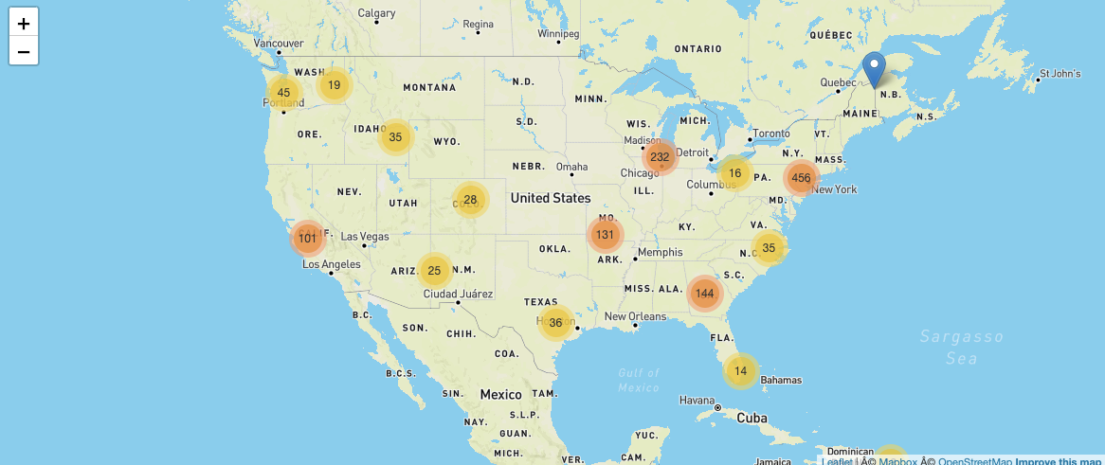
MAP
As with the previous analysis and visualization, we found that starting with a map was the simplest way to convey information.
The map has clustering, and expands when clicked on.
Within the map, we visualize predictions of both presence, and site score.
Notes:
Noah

Slide 14
THE ANALYTICS
Notes:
Noah

Slide 15
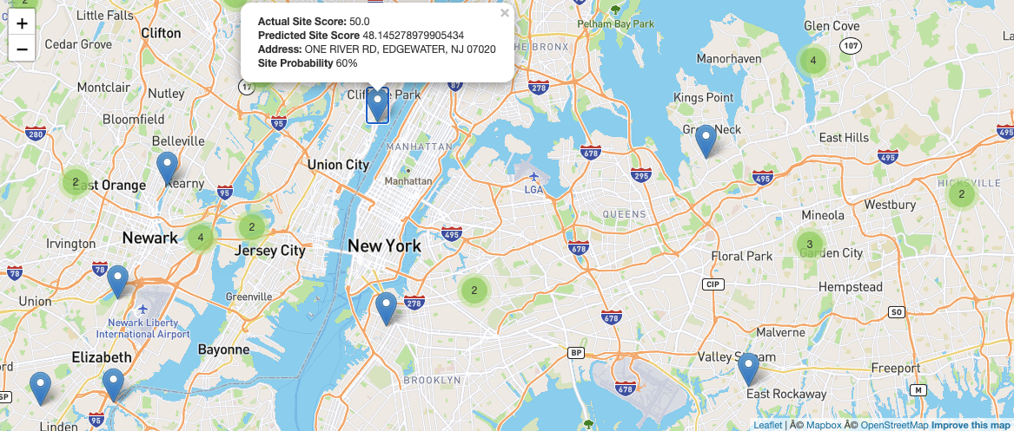
PREDICTIONS
Using the wealth of data we had available to us, we were able to make predictions regarding presence or absence of a site, and site score.
These are displayed visually under the new dashboard.
This is highly relevant, as new sites are placed presently, and will continue to be moving forward.
Getting an estimate for whether an area may have a site, and what site score that unit may have, is valuable for a host of reasons.
Using machine learning we were able, with a high degree of rigor, to make these predictions.
Notes:
Noah

Slide 16
CONCLUSION
Notes:
Re-enter slide deck, Transition Noah → Carl

Slide 17

WHAT DID WE LEARN?
Our models did a rigorous job at predicted the percentage likelihood of sites, as well as the site score, using the methods we have described above.
The website with cluster mapping and clickable entries does a good job of making the data, both that which we initially downloaded, as well as our predictions, accessible and easy to use and understand.
Superfund sites continue to be an Environmental Justice concern, and will continue to be one as new sites are added, with new levels of severity.
Notes:
Carl

Slide 18
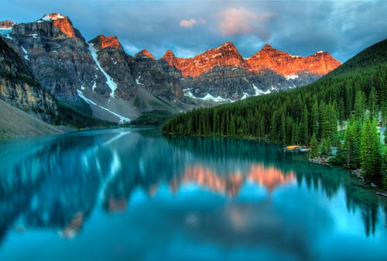
THANK YOU! ANY QUESTIONS?
Notes:
Carl, Everybody

